Slide 1

Customer segmentation in banking to give promotional offers to its customers.
- REKHA WANKHEDE

Slide 2
Executive Summary:
A leading bank wants to develop a customer segmentation to give promotional offers to its customers. They collected a sample that summarizes the activities of users during the past few months. You are given the task to identify the segments based on credit card usage.
Introduction:
The purpose of this Project is to identify the segments based on credit card usage. Based on that bank can give promotional offer accordingly to their customer. 210 customers information of their spending, advance payments, probability_of_full_payment, current_balance, credit limit, min_payment_amt, max_spent_in_single_shopping. To analysis customer segmentation, various technic and models are used such as EDA, DATA visualizing, K-Mean, RF-Model, CART model and helpful insights for business purpose
Data Description:
spending: Amount spent by the customer per month (in 1000s)
advance payments: Amount paid by the customer in advance by cash (in 100s)
probability_of_full_payment: Probability of payment done in full by the customer to the bank
current_balance: Balance amount left in the account to make purchases (in 1000s)
credit limit: Limit of the amount in credit card (10000s)
min_payment_amt: minimum paid by the customer while making payments for purchases made monthly (in 100s)
7. max_spent_in_single_shopping: Maximum amount spent in one purchase (in 1000s

Slide 3
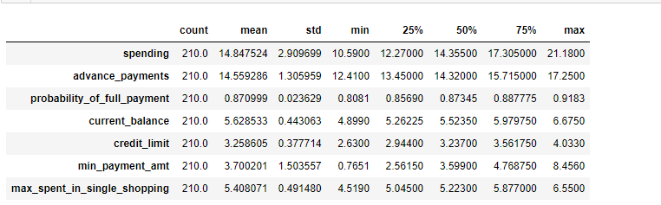
Describing the dataset/Observation
Spending which target variable looks like its normally distributed as we can see that mean and medians are same
Minimum current balance held by customer is 4899.0 and maximum is 6675.0.
minimum min_payment_amt amount is 76.51 and maximum is 845.6. This suggest data is widely spread for this variable and might have outlier
The average of max_spent_in_single_shopping is 5408.07. The maximum of max_spent_in_single_shopping is 6550.00.
Advance payment also seems to be normal distributed, this variable might be use as it shows that customers are paying the amount in advance which is timely payment of bank.
The average of probability_of_full_payment is 87.099% hence we need to analysis the rest of customer who falls in 13% who have not done the payment in full. This variable is normally distributed
credit limit range between 2630.0 to 4033.0, The average credit limit of customers is 32586.05.

Slide 4
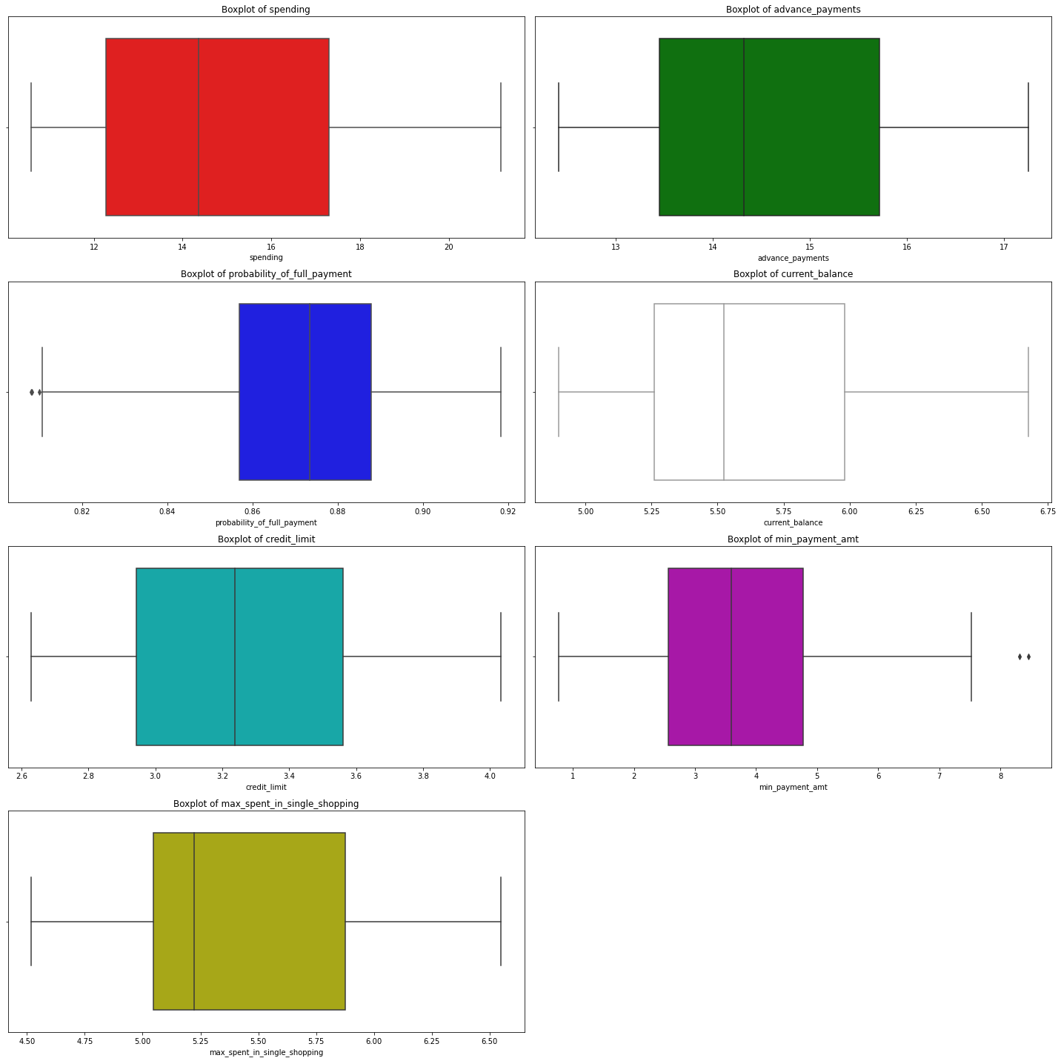
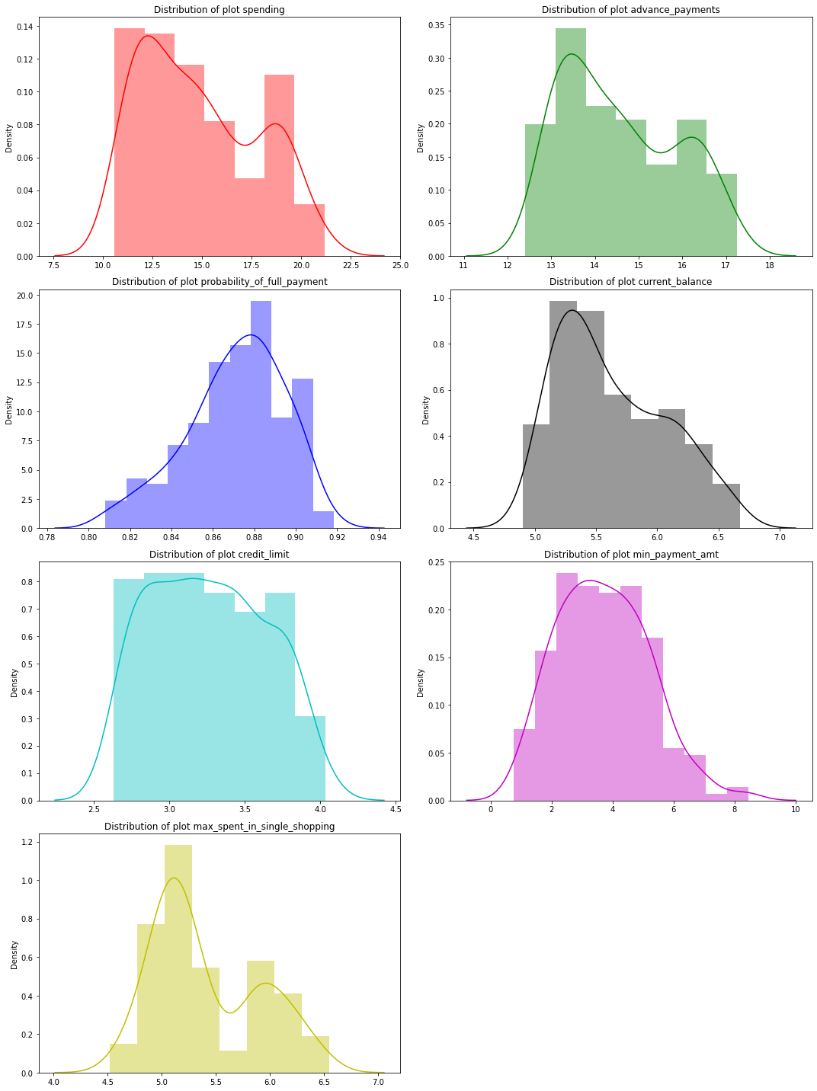
Exploratory Data Analysis: Lets check symmetry and skewed with BOX PLOT:
Distribution Plot:

Slide 5
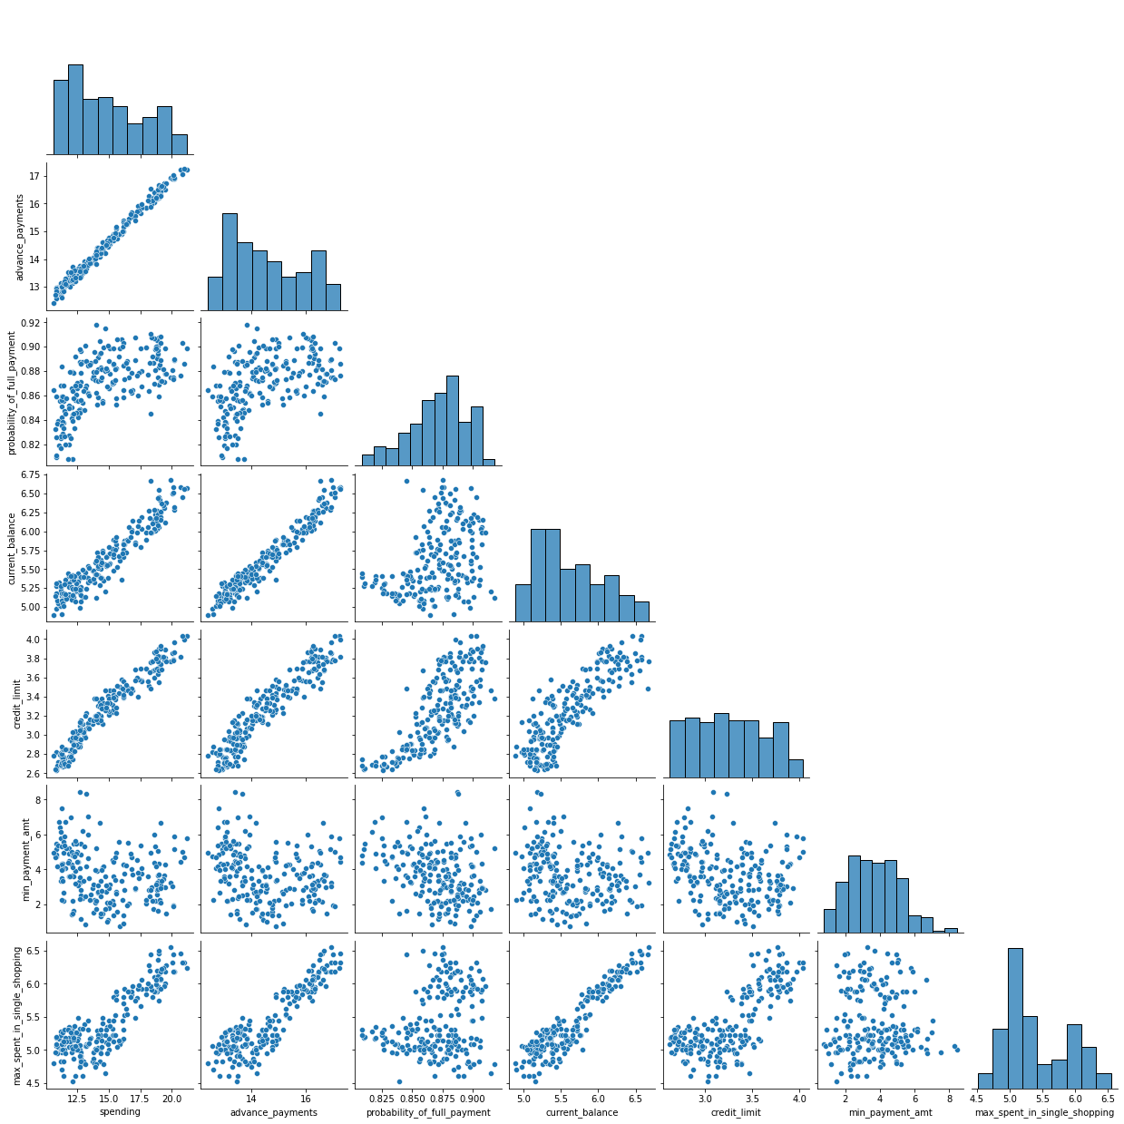
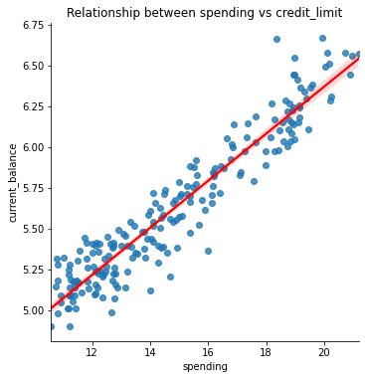
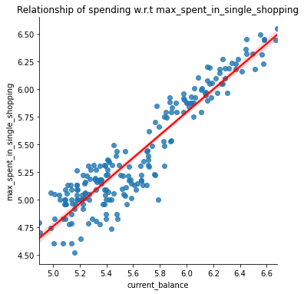
Exploratory Data Analysis: Bivariate Analysis #Pairplots

Slide 6
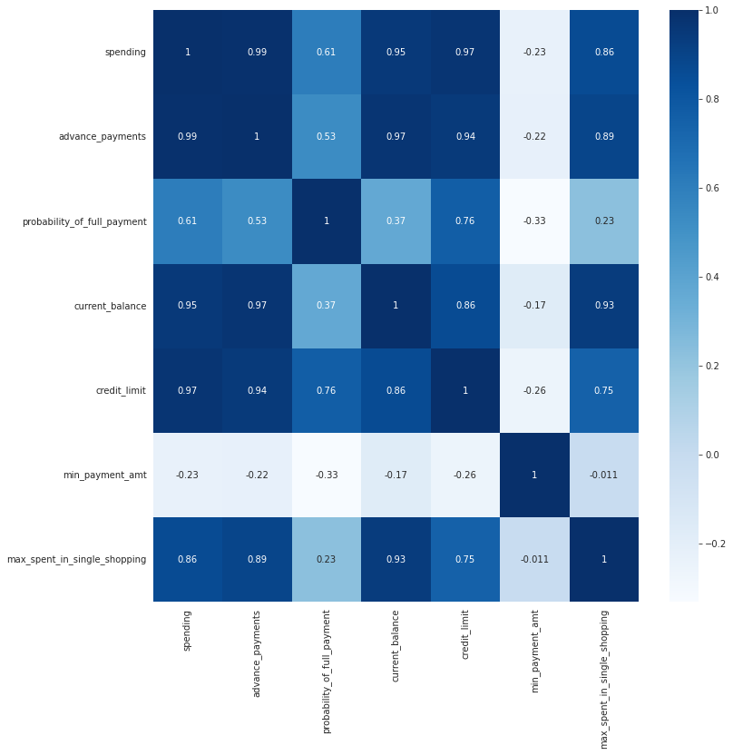
from above pair plot and heatmap we can see that there is positive linear relationship between advance payments and spending, current_balance and spending, credit_limit and spending, current_balance and advance payments, credit_limit and advance payments, max_spent_in_single_shopping and current_balance. This suggests that there is Multicollinearity between the variables.

Slide 7
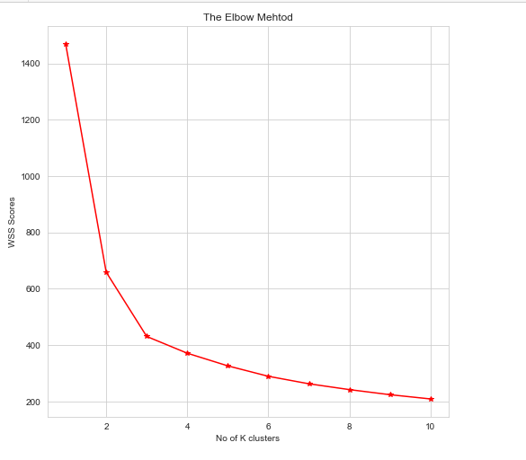
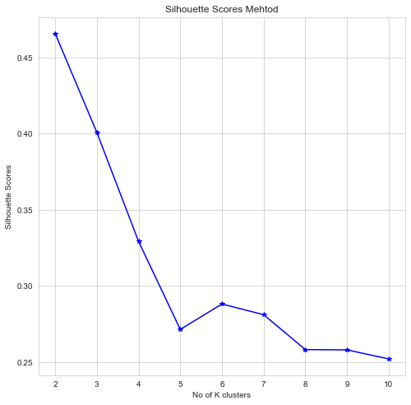

Apply K-Means clustering on scaled data and determine optimum clusters
# forming 3 clusters with K = 3
KMeans(n_clusters=3)
WSS scores keep reducing as we increase the number of clusters
Cluster evaluation for 3 clusters:
The Silhouette score for 3 cluster is 0.40072705527512986
Checking with Elbow Method
Elbow method with Silhouette score vs No of K-clusters
# Cluster frequency

Slide 8
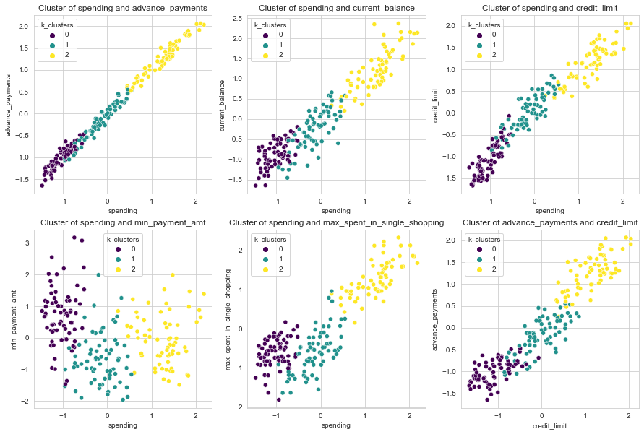
Describe cluster profiles for the clusters defined. Recommend different promotional strategies for different clusters. K-means Clusters Scatterplot

Slide 9
Business insights based on Cluster profiles
When we look at final cluster merge at original data set and take average value of the variable . below is the recommendation
Customers under cluster 2 have a high spending, current balance, credit_limit and max_spent_in_single_shopping which clearly shows that they are premium high-net worth customers who make expensive purchases on their credit cards.
lesser spending, current balance, credit_limit and max_spent_in_single_shopping which indicate that they are upper middle-cCustomers under cluster 1 have a relatively lass customers. The bank can provide promotional offers to this segment such that they increase their spending and are potential customers who can move into premium segments.
Customers under cluster 0(3rd cluster) have the least spending and credit_limits compared to other clusters. This signifies that they are customers who have recently bought credit cards or youths who have started working recently. Bank can provide customized offers to this segment to promote more spending on credit cards

Slide 10
Thank You!

